Slide 1

Improving Search applied to Paintshop Schedule
Made by Yvonne Nieuwdorp en Fleur van Dijk

Slide 2
Contents
Problem definition
Research approach
Designing Heuristic based on Improving Search
Discrete Improving Search: Logic
Discrete Improving Search: Tests and Experiments
Discrete Improving Search: Schedule visualisations
Simulated Annealing: Logic
Simulated Annealing: Tests and Experiments
Simulated Annealing: Schedule visualisations
Comparing methods
Python Implementation
Organization of code
Conclusion
Realized Depth in OR

Slide 3
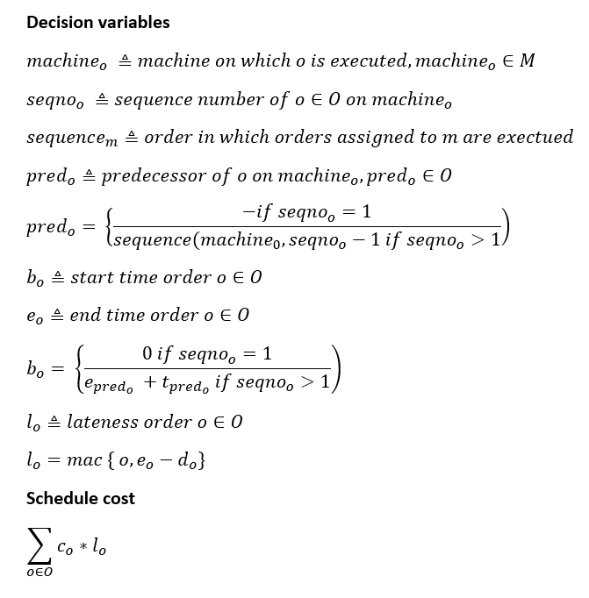
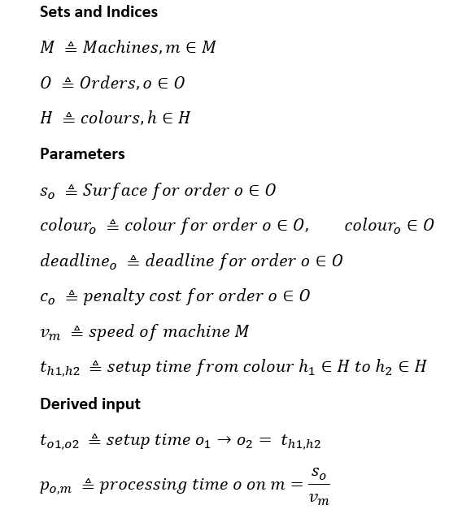
Problem Definition

Slide 4
Research Approach
Literature
R. Rardin (2014), Optimization in Operations Research, Pearson New International Edition
Use of other external sources
Chat GPT 4.0
Making a start structure of algorithm Constructive Heuristic
Calculating costs Discrete Improving Search
Making a start structure of algorithm Simulated Annealing
Start structure Gantt chart

Slide 5
Design Heuristic based on Improving Search
Accountability Chosen 2 Neighbourhoods
Ensures improvements of sufficient quality within a reasonable time
Efficient and feasible in terms of calculation costs
Flexible enough
Neighbourhood structures
Best cost: The order machine combination with the lowest cost are chosen as the best option.
Deadline: The order is chosen with the closest deadline and checks the machine with the lowest working pressure.
Accountability Heuristic
Discrete Improving Search
Step-by-step improvement that is logical and easy to implement in the search process
Less time-consuming
Simulated Annealing
It goes to a random solution and checks if the new cost is better or worse. If it is better, it excepts it as it is and if it is worse, it is accepted with a probability based on the temperature and the difference in costs.

Slide 6
Discrete Improving Search: Logic
Step 1: initialize
Set current_schedule to initial_schedule
Set current_costs as initial costs
Set improved to true
Step 2: Main
While improved: Set improved to False
Step 3: Check neighborhood
FOR i FROM 0 TO length(current_schedule) - 2
FOR j FROM i + 1 TO length(current_schedule) - 1
Step 4: Make a copy of current schedule
Step 5: Swap orders on position i and j
Step 6: recalculate costs of the new schedule
Step 7: check if the new schedule is better
Step 8:
If there is no improvement, then return best schedule
Otherwise, return to step 1
Notes:
Tijdcomplexiteit bepaald en benoemd

Slide 7
Discrete Improving Search: Tests and Experiments
Started with Roys code on Discrete Improving Search on Traveling Salesman Problem
This code was not complete for the current problem
Double-checked implementation of Constructive Heuristic
Double-checked implementation of Discrete Improving Search for current Problem:
Costs were not calculated
Different parameters
Code extensions
Other calculations for the gain: calculating the cost of the scheme
Gantt chart for visualizing the schedule
Height of costs visualized as moves move closer to local optimum
Tests:
Different initial schedules: Best Costs and Deadline
Visually inspected Gantt chart

Slide 8
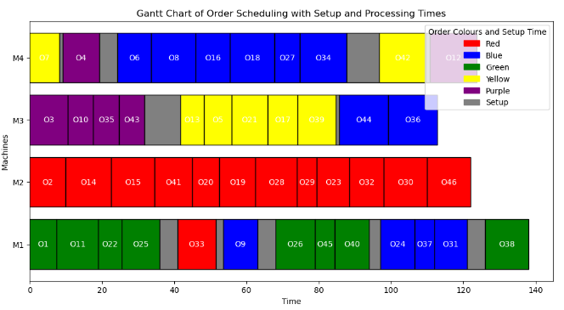
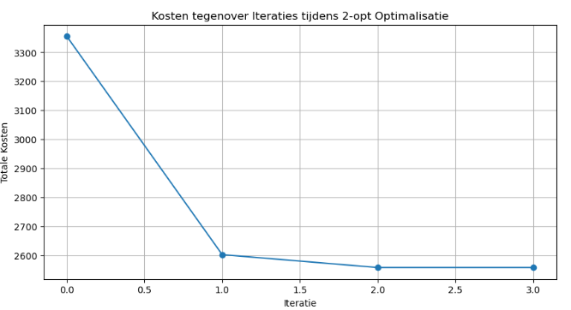
Discrete Improving Search: Schedule visualisations
Costs = 2557.65
Time taken = 495.80 sec
Initial Schedule = Best Costs
Notes:
nitial cost: 6393.91 Improved cost: 5308.74 Time taken: 7.75 seconds

Slide 9
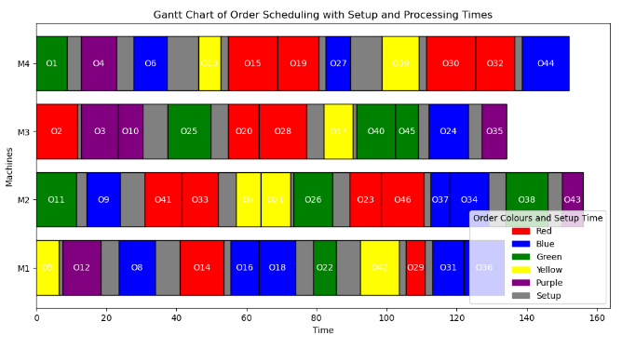
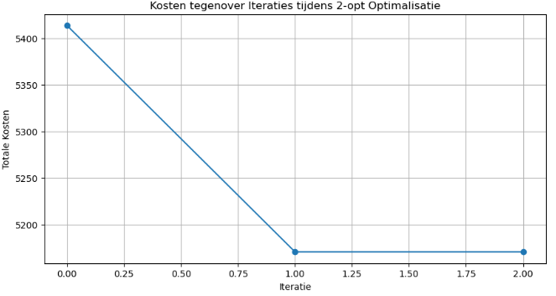
Discrete Improving Search: Schedule visualisations
Costs = 5170.91
Time taken = 263.89 sec
Initial Schedule = Deadline

Slide 10
Simulated Annealing: Logic
For each order in the new schedule:
Calculate the required setup_time for a color change.
Calculate the processing_time based on machine speed and order surface area.
Update the start and end times for the order.
Calculate the lateness and penalty_cost.
Compute new_cost for the new schedule.
Step 3: Check Acceptance Criteria
Compare new_cost with current_cost:
If new_cost < current_cost, accept the new schedule.
If new_cost ≥ current_cost, accept the schedule with a probability based on temperature and the difference in costs (acceptance_probability).
Update the schedule:
If the new schedule is better than the best so far (new_cost < best_cost), set it as best_schedule and update best_cost.
Decrease the temperature (temperature *= cooling_rate).
Step 4: Results and Visualizations
Print the costs per iteration and the final result with total costs.
Visualize the costs and temperature per iteration.
Plot a Gantt chart for the optimal schedule (best_schedule) to show setup and processing times.
Step 1: Initialize Parameters
Set the initial parameters:
initial_temperature = 100000000
cooling_rate = 0.99995
iterations_per_temperature = 150000
machine_list = Machines (list of available machines)
Initialize variables:
best_schedule = schedule_best_costs (initial schedule with best costs)
current_schedule = schedule_best_costs
best_cost = total_schedule_cost(best_schedule)
current_cost = best_cost
temperature = initial_temperature
Lists to keep track of costs and iteration log.
Step 2: Iterate through Temperature Levels
Repeat for each iteration from 1 to iterations_per_temperature:
Determine a new potential solution by:
Either swapping two orders in the schedule (50% chance)
Or assigning an order to a different machine (50% chance)
Notes:
- Engels zetten
Geen we-vorm

Slide 11
Simulated Annealing: Tests and Experiments
Started with de Discrete improving search from Yvonne and a snippet from ChatGPT.
This code had a very small problem instance on 4 points
Double-checked the code from Constructive Heuristic: OK
Double-checked implementation of Simulated Annealing: NOK
Didn't export a excel file with the data
It wasn't flexible enough so that other data could run on it.
Didn't keep an iteration log that gives me a visual of the temperature, best cost and the current cost.
Didn’t visualize a Gantt chart
Code extensions
Implemented a code that export a file if you run the code.
Changed the code so that it would be flexible enough
Implemented an iteration log
Implemented a code that gives me a visual of the temperature, best cost and the current cost.
Implemented a code that visualizes a Gantt chart
Tests:
Simulated Annealing was run on chosen iteration numbers 100, 1.000 and10.000
Ran experiments with different lengths of the cooling rate and the initial temperature
Visually inspected Gantt chart : results are expected

Slide 12
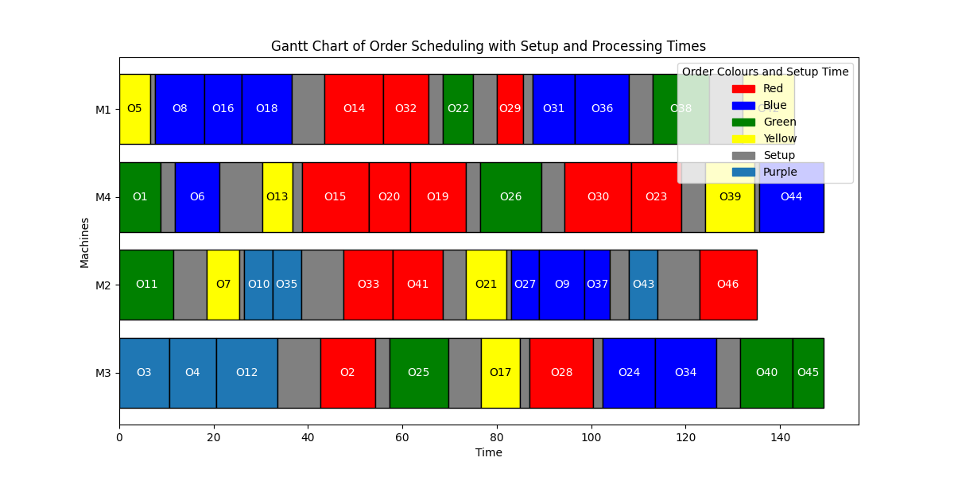
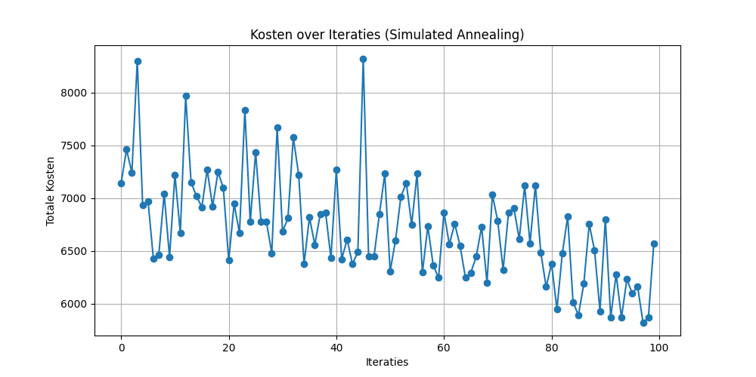
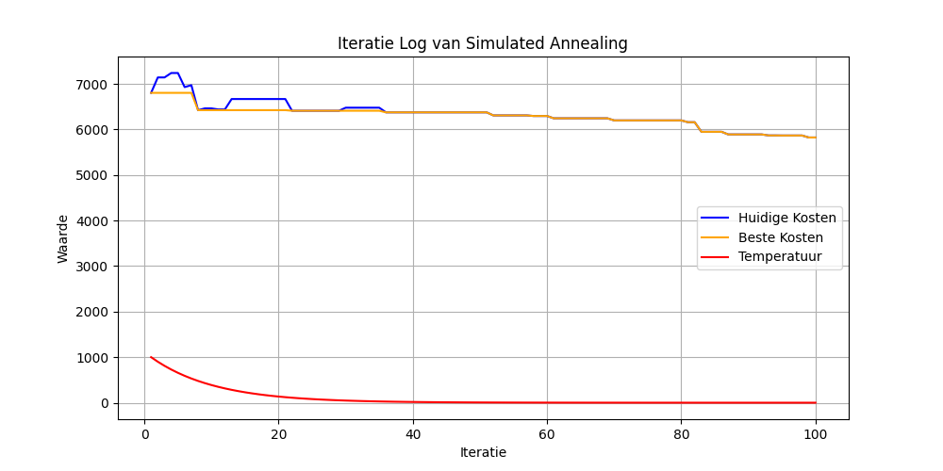
Simulated Annealing: Schedule visualisations
Iterations = 100
Costs = 5823.91
Time taken = 139.56 sec
Initial Schedule = Deadline

Slide 13
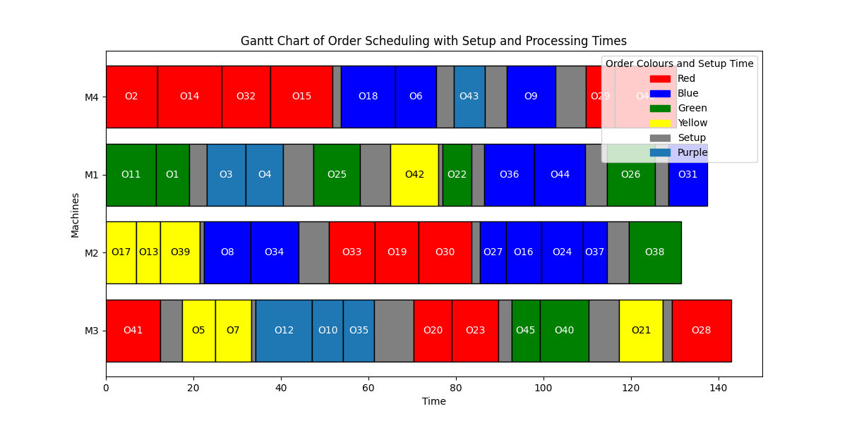
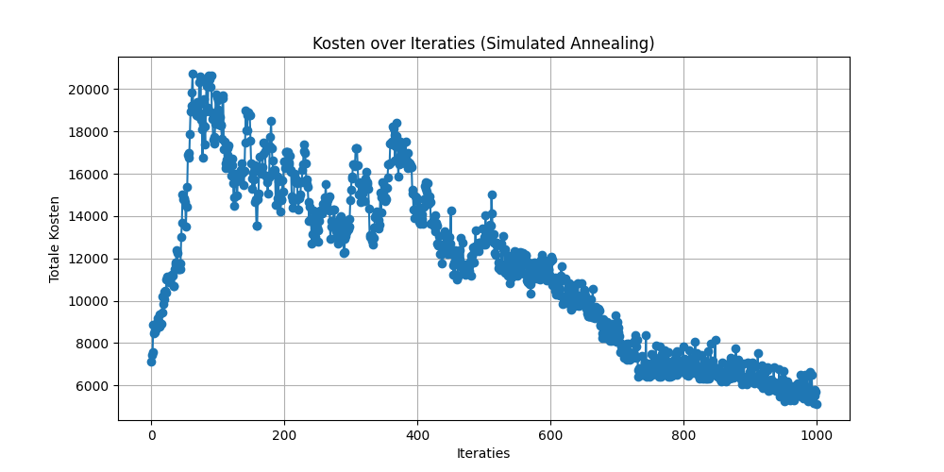
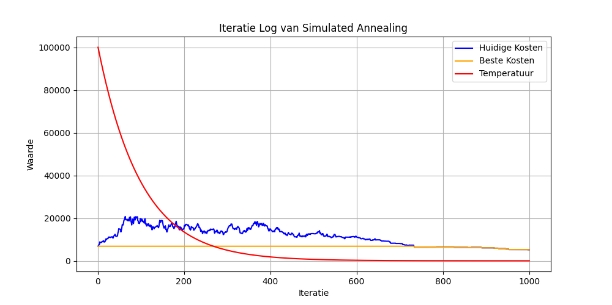
Simulated Annealing: Schedule visualisations
Iterations = 1000
Costs = 5140.79
Time taken = 114.40 sec
Initial Schedule = Deadline

Slide 14
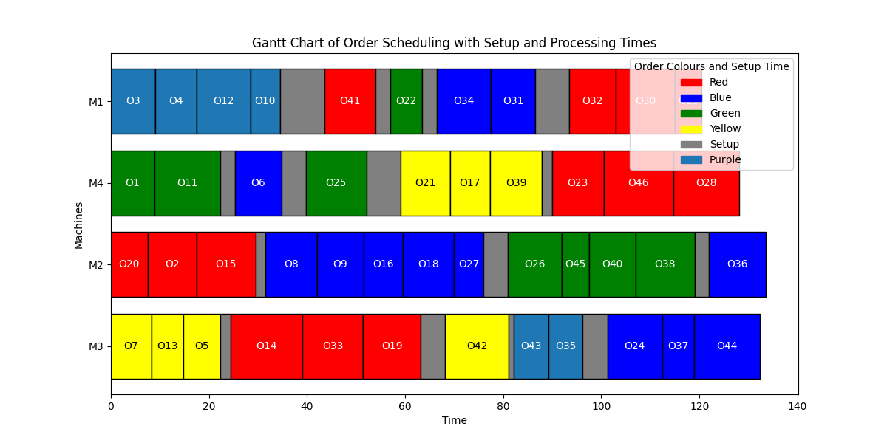
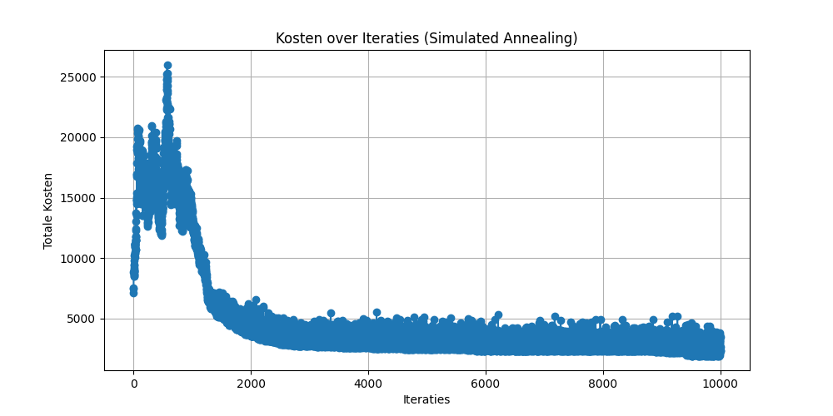
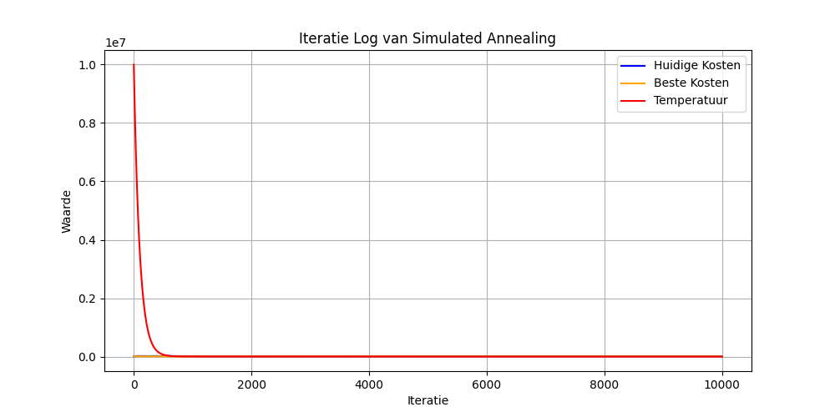
Simulated Annealing: Schedule visualisations
Iterations = 10.000
Costs = 1917.74
Time taken = 735.69 sec
Initial Schedule = Deadline

Slide 15
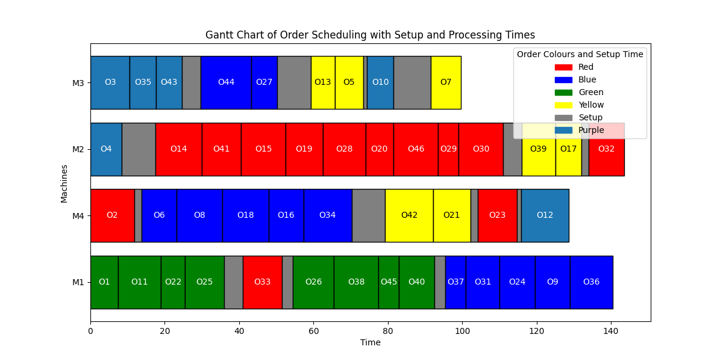
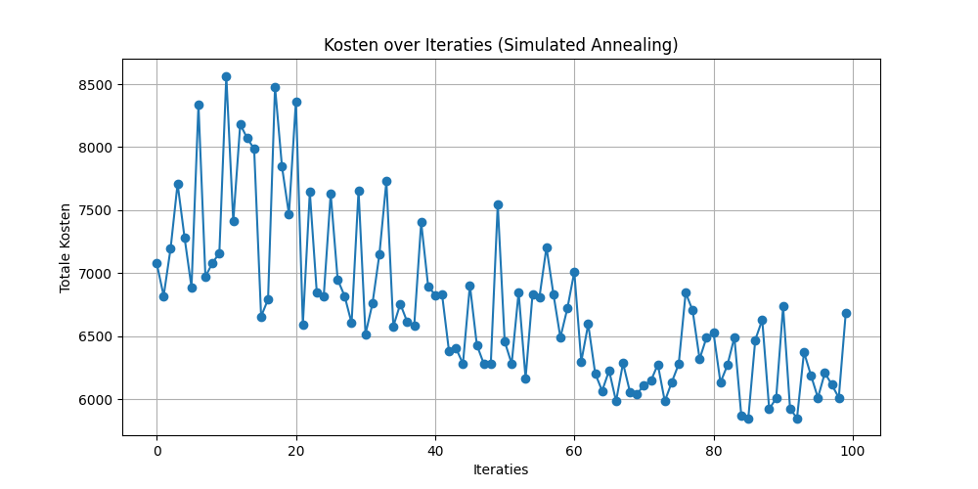
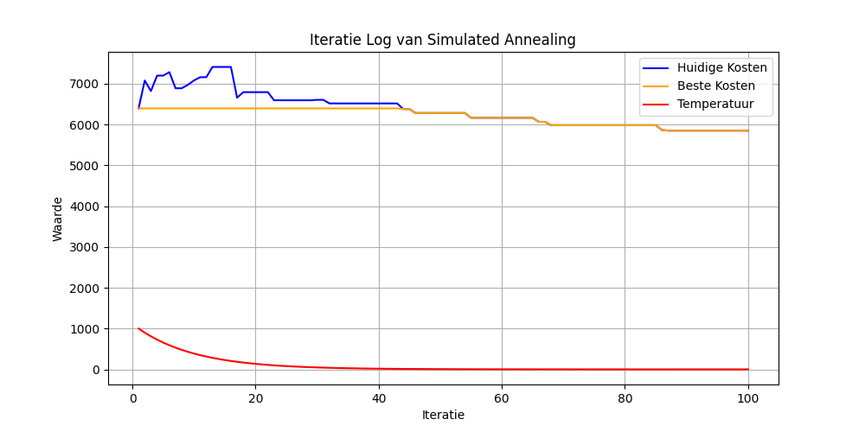
Simulated Annealing: Schedule visualisations
Iterations = 100
Costs = 5849.50
Time taken = 57.96 sec
Initial Schedule = Best Costs

Slide 16
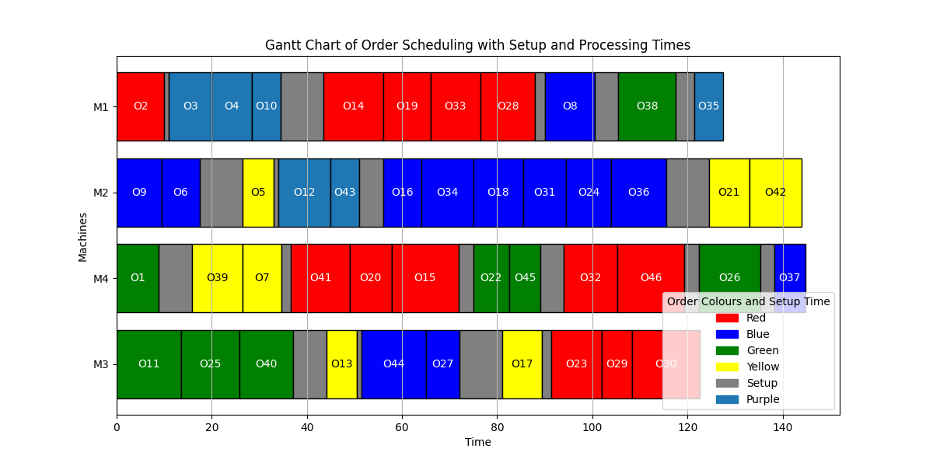
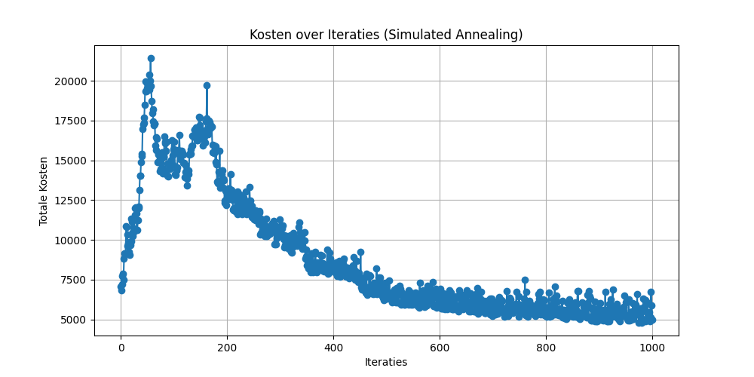
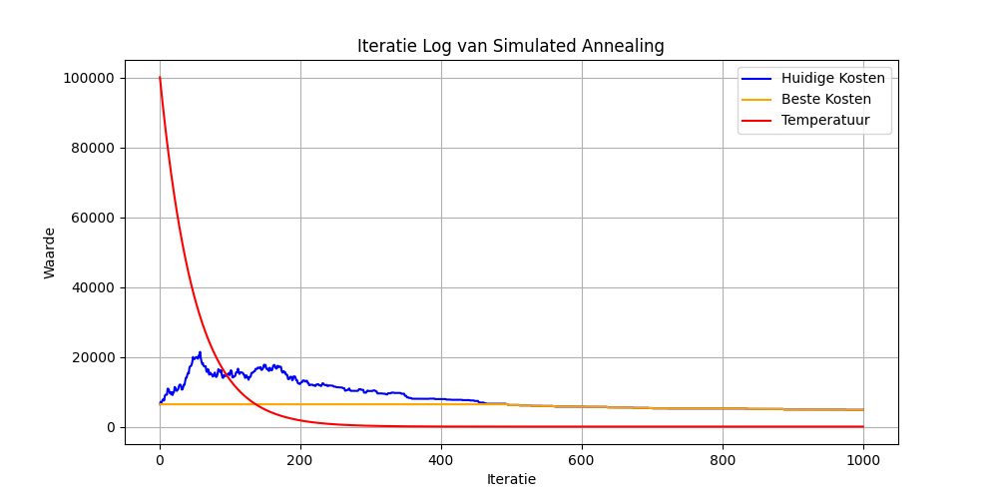
Simulated Annealing: Schedule visualisations
Iterations = 1.000
Costs = 4811.44
Time taken = 127.84 sec
Initial Schedule = Best Costs

Slide 17
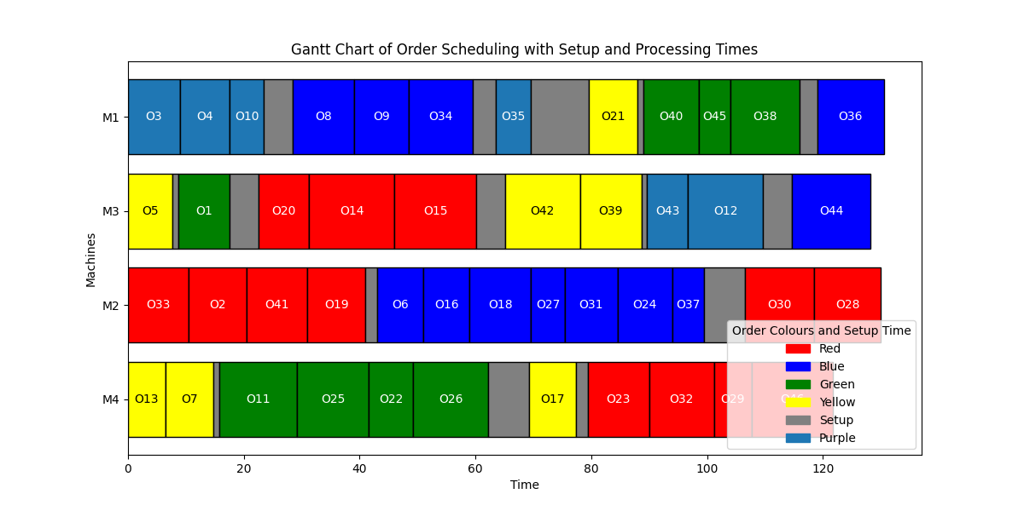
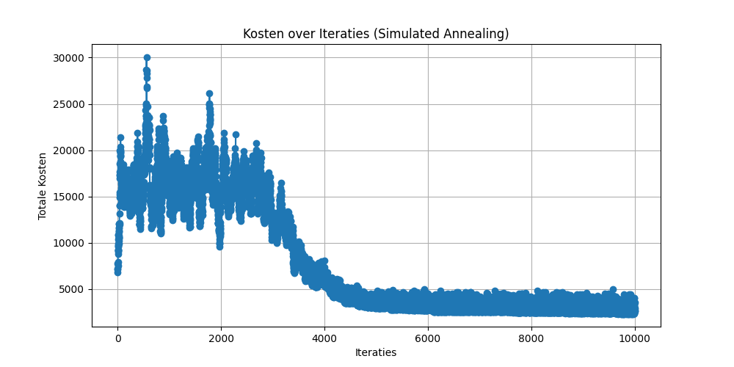
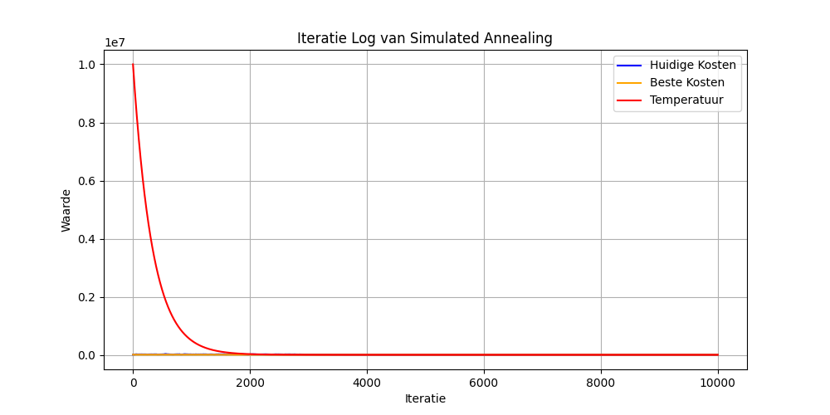
Simulated Annealing: Schedule visualisations
Iterations = 10.000
Costs = 2309.85
Time taken = 559.15 sec
Initial Schedule = Best Cost

Slide 18
Comparing methods
Initial Schedule : Best Costs
Initial Schedule : Deadline
Type | Iterations | Time (sec) | Costs
Constructive Heurisic | - | 3.12 | 6393.91
Discrete Improving Search | 3 | 495.90 | 2557.65
Simulated Annealing | 100 | 57.96 | 5849.50
Simulated Annealing | 1.000 | 127.84 | 4811.44
Simulated Annealing | 10.000 | 559.15 | 2309.85
Type | Iterations | Time (sec) | Costs
Constructive Heurisic | - | 2.09 | 6803.82
Discrete Improving Search | 2 | 263.89 | 5170.91
Simulated Annealing | 100 | 139.56 | 5823.91
Simulated Annealing | 1.000 | 114.40 | 5140.79
Simulated Annealing | 10.000 | 735.69 | 1917.74
Notes:
Als er de twee methodes discrete improving search en simulated annealing met elkaar worden vergeleken, kan er op basis van deze gegevens geconcludeerd worden dat de uiteindelijke uitkomsten bij elkaar in de buurt liggen. Hoe hoger de iteraties bij simulated annealing, hoe lager de kosten worden. Dit vraagt wel meer tijd. Als er weinig iteraties worden gebruikt, geeft dit al een goede verbetering en duurt dit relatief kort. Discrete improving search duurt relatief lang, omdat het lang duurt voordat er door het hele dataframe is geitereerd. Het geeft wel een goede verbetering. Het is alleen wel een lokaal optimum, dus er kan niet met zekerheid gezegd worden dat dit de meest optimale oplossing is.

Slide 19
Python Implementation
Sets
Orders, set of all orders O ={0,1,…, 29}
Machines, set of all machines M={1,2,3}
Setups, set of all setup times H = {6, 2, …, 4}
Functions defined
processing_time
Description: Calculates the processing time required for a specific order on a given machine.
Input: ordernumber (the number of the order), machine_idx (the index of the machine).
Output: The time required to execute the order, known as the processing time.
setup_time
Description: Retrieves the setup time needed to switch from one color to another.
Input: prev_colour (the current color on the machine), new_colour (the new color needed for the next order).
Output: The setup time required to prepare the machine for the new color.
total_schedule_cost
Description: Calculates the total cost of the current schedule by summing the penalty costs for all orders.
Input: results_df (DataFrame with information on the orders, including penalty costs).
Output: The total penalty cost for all orders in the schedule.
swap_orders
Description: Swaps the positions of two random orders in the schedule to create an alternative sequence.
Input: results_df (DataFrame containing the current orders and their sequence).
Output: A new DataFrame with a modified sequence of orders.
Notes:
Indentificatienamen
Functions yvonne

Slide 20
Python Implementation
reassign_machine
Description: Reassigns a random order to a different machine.
Input: results_df (DataFrame containing the current orders and machine assignments).
Output: A new DataFrame in which an order has been assigned to a different machine.
acceptance_probability
Description: Calculates the probability of accepting a new solution, even if the cost is higher than the current solution’s cost.
Input: old_cost (cost of the current solution), new_cost (cost of the new solution), temperature (current temperature in the simulated annealing process).
Output: A probability value indicating whether the new solution should be accepted.
simulated_annealing_search
Description: Performs the simulated annealing algorithm to optimize the schedule by repeatedly swapping orders and reallocating them across machines, occasionally accepting worse solutions to escape local minima.
Input: results_df (DataFrame with the current order schedule), iterations (number of iterations), initial_temperature (starting temperature), cooling_rate (rate of cooling per iteration).
Output: The best order schedule found during the process.
plot_gantt_chart
Description: Visualizes the order schedule in a Gantt chart to show the timing distribution of orders across machines, including setup and processing times.
Input: schedule_df (DataFrame containing order details such as start and end times, color, and machine).
Output: A Gantt chart that graphically displays how orders are scheduled overtime and across machines.
Notes:
Indentificatienamen
Functions yvonne

Slide 21
Organization of code
There are 3 files containing Constructive Heuristic, Discreet Improving Search and Simulated Annealing.
• Constructive Heuristic: Gives 2 feasible solutions in excel format • Discrete Improving Search is implemented in function two_opt • Simulated Annealing is implemented in function simulated_annealing_search

Slide 22
Conclusion
When comparing the two methods discrete improving search and simulated annealing, it can be concluded based on this data that the final results are close to each other.
The higher the iterations with simulated annealing, the lower the costs become. This does take more time. If few iterations are used, this already gives a good improvement and takes a relatively short time.
Discrete improving search takes a relatively long time, because it takes a long time to iterate through the entire data frame. It does give a good improvement. However, it is a local optimum, so it cannot be said with certainty that this is the most optimal solution.
different initial schemes give a good picture and allows you to check yourself. It also gives more options to come to a solution.

Slide 23
Realized Depth in OR
Implemented constructive heuristic Nearest Neighbor
Implemented Discrete Improving Search
Implemented Simulated Annealing
Compared performance between Constructive Heuristic, Discrete Improving Search, Simulated Annealing based on a number of experiments

